Slide 1
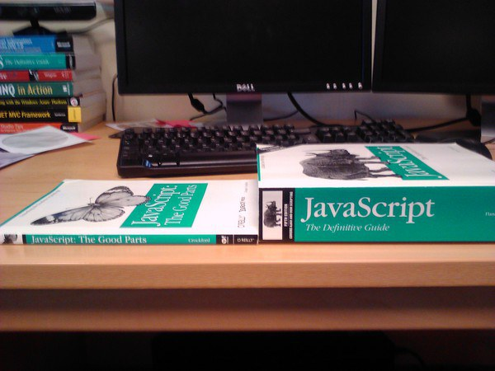
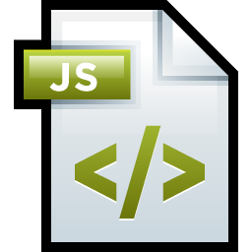
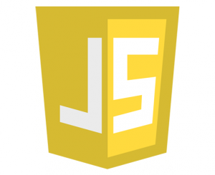

Introduction to JavaScript
Past, Present and Future
Nikolay Kostov
Team Lead, Senior Developer and Trainer
http://Nikolay.IT
Telerik Software Academy
academy.telerik.com

Slide 2

Table of Contents
JavaScript Overview
History
Features
Usage
Present and Future
Running JavaScript in the Browser

Slide 3

JavaScript Overview

Slide 4

JavaScript Overview
JavaScript is an interpreted computer programming language
Runs mostly in a web browser
Allows user interaction
JavaScript is formalized in ECMAScript language standard

Slide 5

Features
Why JavaScript is so good!

Slide 6

Features
DOM and UI manipulation
Platform independent / works everywhere!
Imperative and structured
if-else, for, while, …
Scoping
Expressions and statements
Dynamic
Typeless

Slide 7

Features
Functional
Prototype-based
Class-like structures and inheritance
Functions as objects
Functions as methods
Other
Run-time environment
Regular expressions
Lightweight

Slide 8
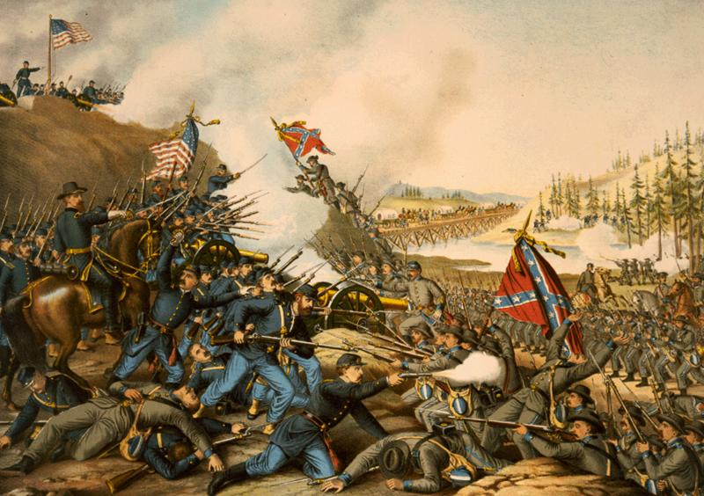
History of JavaScript
How has JS risen to power?

Slide 9

History of JavaScript
JavaScript was originally developed for Netscape at the beginning of the Browser wars
Shipped with Netscape Navigator 2.0, 1995
Developed as Mocha, later known as LiveScript
Microsoft adopted JavaScript in their browser (IE 3.0) in August 1996
MS JS was called JScript and was promoted with the umbrella term DHTML
JS became official as ECMAScript

Slide 10

History of JavaScript (2)
AJAX came into play
Content is loaded in the background with JS
Open source libraries
jQuery
Prototype
JavaScript became popular in 2009
ECMAScript 5

Slide 11

Present and future
Where are we going?

Slide 12



Present
AJAX content loading
HTML5 API
JS to control user media
RIA applications
Server-side
NodeJS
Web Sockets
Fast communication

Slide 13

Future
Most used programming language
Used absolutely everywhere
And on every layer of development
Data layer
Server-side layer
Clients on
Web
Mobile
Desktop

Slide 14
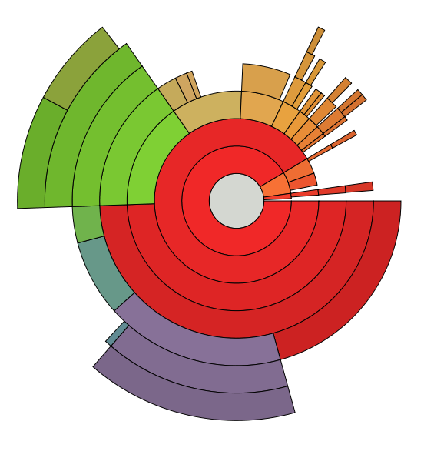
Usage
Not only web!

Slide 15

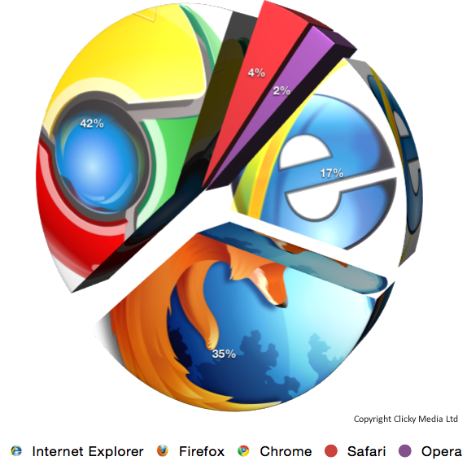
Usage
Architecture
MVVM, MVC and MVP
Ready-to-use libraries
Web
UI
DOM manipulation
Single page applications

Slide 16

Usage
Mobile
Cross-platform hybrid applications
Cordova, Titanium, Firefox OS
Desktop
Windows 8 JS
Server-side
NodeJS
Database
MongoDB

Slide 17
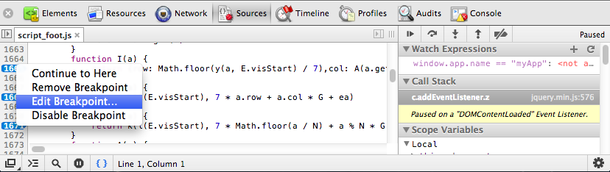
Running JavaScript in the Browser

Slide 18
Using JavaScript Code
The JavaScript code can be placed in:
<script> tag in the head
<script> tag in the body
External files, linked via <script> tag the head
Files usually have .js extension
Highly recommended
The .js files get cached by the browser
<script src="scripts.js" type="text/javscript">
<!– code placed here will not be executed! -->
</script>

Slide 19
JavaScript – When is Executed?
JavaScript code is executed during the page loading or when the browser fires an event
All statements are executed at page loading
Some statements just define functions that can be called later
Function calls or code can be attached as "event handlers" via tag attributes
Executed when the event is fired by the browser
<img src="logo.gif" onclick="alert('clicked!')" />

Slide 20
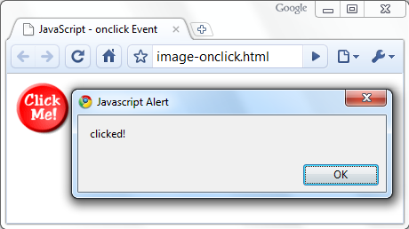
Calling a JavaScript Function from Event Handler – Example
<html>
<head>
<script type="text/javascript">
function test (message) {
alert(message);
}
</script>
</head>
<body>
<img src="logo.gif"
onclick="test('clicked!')" />
</body>
</html>

Slide 21
Event Handlers
Live Demo

Slide 22
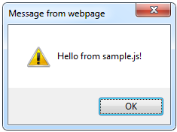
Using External Script Files
Using external script files:
External JavaScript file:
<html>
<head>
<script src="sample.js" type="text/javascript">
</script>
</head>
<body>
<button onclick="sample()" value="Call JavaScript
function from sample.js" />
</body>
</html>
external-JavaScript.html
The <script> tag is always empty.
function sample() {
alert('Hello from sample.js!')
}
sample.js

Slide 23
External JavaScript Files
Live Demo

Slide 24
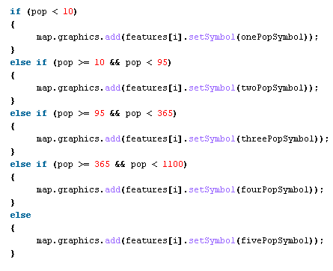

The JavaScript Syntax

Slide 25
JavaScript Syntax
JavaScript is a C-like programming language
It gets its syntax from C, and maybe Java
Operators (+, *, =, !=, &&, ++, …)
Variables (typeless)
Conditional statements (if, else)
Loops (for, while)
Arrays (my_array[]) and associative arrays (my_hash['key'])
Functions (can return value)
Function variables

Slide 26
Standard Popup Boxes
Alert box with text and [OK] button
Just a message shown in a dialog box:
Confirmation box
Contains text, [OK] button and [Cancel] button:
Prompt box
Contains text, input field with default value:
alert("Some text here");
confirm("Are you sure?");
prompt ("enter amount", 10);

Slide 27
Popup Boxes
Live Demo

Slide 28


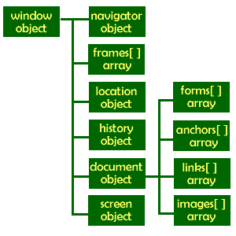
The Built-In Browser Objects

Slide 29
Built-in Browser Objects
The browser provides some read-only data via:
window
The top node of the DOM tree
Represents the browser's window
document
holds information the current loaded document
screen
Holds the user’s display properties
browser
Holds information about the browser

Slide 30
DOM Hierarchy – Example
window
navigator
screen
document
history
location
form
form
button
form

Slide 31
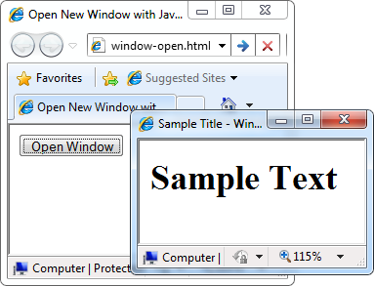
Opening New Window – Example
window.open()
var newWindow = window.open("", "sampleWindow",
"width=300, height=100, menubar=yes,
status=yes, resizable=yes");
newWindow.document.write(
"<html><head><title>
Sample Title</title>
</head><body><h1>Sample
Text</h1></body>");
newWindow.status =
"Hello folks";

Slide 32
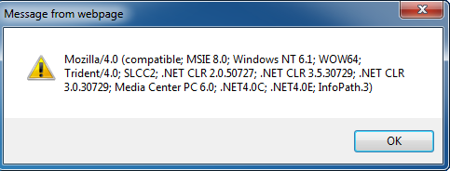
The Navigator Object
The browser window
The navigator in the browser window
The userAgent (browser ID)
alert(window.navigator.userAgent);

Slide 33

The Screen Object
The screen object contains information about the display
window.moveTo(0, 0);
x = screen.availWidth;
y = screen.availHeight;
window.resizeTo(x, y);

Slide 34
Document and Location
document object
Provides some built-in arrays of specific objects on the currently loaded Web page
document.location
Used to access the currently open URL or redirect the browser
document.links[0].href = "yahoo.com";
document.write(
"This is some <b>bold text</b>");
document.location = "http://www.yahoo.com/";

Slide 35
Built-In Browser Objects
Live Demo

Slide 36

Other JavaScript Objects

Slide 37
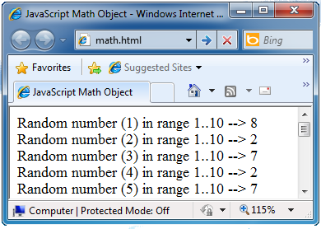
The Math Object
The Math object provides some mathematical functions
for (i=1; i<=20; i++) {
var x = Math.random();
x = 10*x + 1;
x = Math.floor(x);
document.write(
"Random number (" +
i + ") in range " +
"1..10 --> " + x +
"<br/>");
}

Slide 38
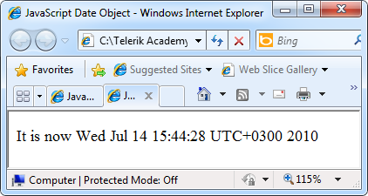
The Date Object
The Date object provides date / calendar functions
var now = new Date();
var result = "It is now " + now;
document.getElementById("timeField")
.innerText = result;
...
<p id="timeField"></p>

Slide 39
Timers: setTimeout()
Make something happen (once) after a fixed delay
var timer = setTimeout('bang()', 5000);
5 seconds after this statement executes, this function is called
clearTimeout(timer);
Cancels the timer

Slide 40
Timers: setInterval()
Make something happen repeatedly at fixed intervals
var timer = setInterval('clock()', 1000);
This function is called continuously per 1 second.
clearInterval(timer);
Stop the timer.

Slide 41
Timer – Example
<script type="text/javascript">
function timerFunc() {
var now = new Date();
var hour = now.getHours();
var min = now.getMinutes();
var sec = now.getSeconds();
document.getElementById("clock").value =
"" + hour + ":" + min + ":" + sec;
}
setInterval('timerFunc()', 1000);
</script>
<input type="text" id="clock" />

Slide 42
Other JavaScript Objects
Live Demo

Slide 43
Introduction to JavaScript Development
http://academy.telerik.com

Slide 44




Free Trainings @ Telerik Academy
“C# Programming @ Telerik Academy
csharpfundamentals.telerik.com
Telerik Software Academy
academy.telerik.com
Telerik Academy @ Facebook
facebook.com/TelerikAcademy
Telerik Software Academy Forums
forums.academy.telerik.com

